Slide 1
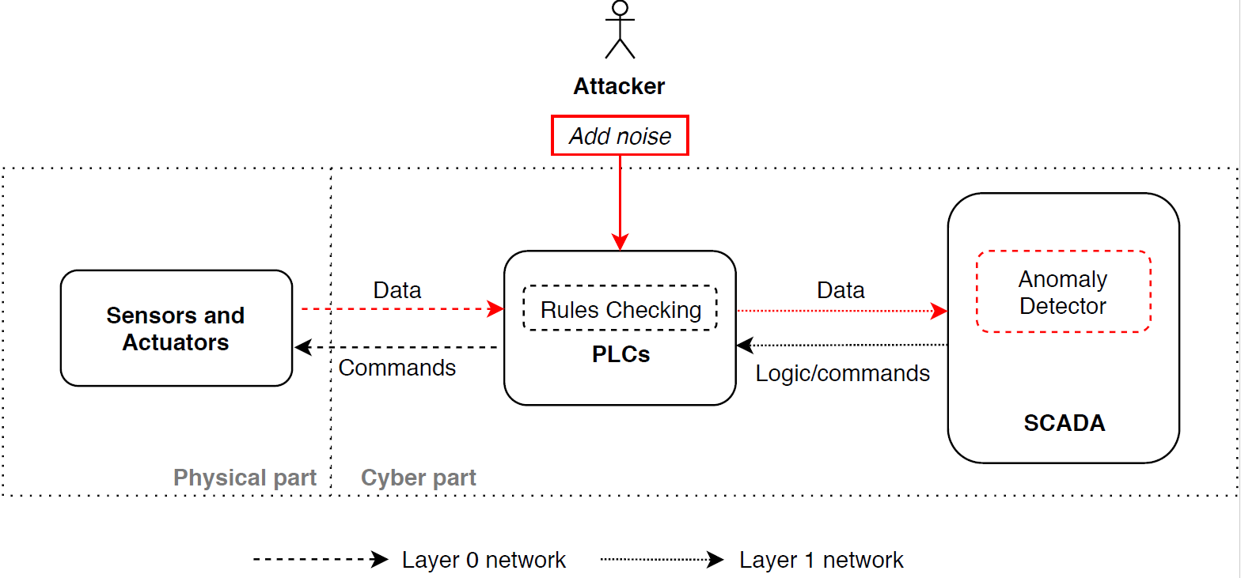
Research progress
Work: Attack and defense on RNN classifier overview
Experiment 1: Train RNN classifier for CPS
Experiment 2: Apply adversarial attacks on RNN anomaly detectors
Experiment 3: Possible defense

Slide 2
Research progress
Work: Attack and defense on RNN classifier
Experiment 1: Testing RNN classifiers from others (done)
Experiment 2: Apply adversarial attacks (FGSM) thread model on RNN anomaly detectors (done)
Consider GA to generate adversarial samples when considering property checker (working)
Experiment 3: Design defense for noise detection by DNN for noise detection first (working)
Break the defense with FGSM (may improve in the future)
Experiment 4: Apply the thread and defense model to the CPS in other domain (WADI)
After improve loss | precision | recall | f1 | accuracy | Accuracy for ATTACKs
Original Anomaly Detector | 0.83 | 0.62 | 0.71 | 94% | 20/36
After adding noises to sensor (10%) | 0.82 | 0.62 | 0.71 | 94% | 19/36
After adding noises to all data | 0.12 | 0.78 | 0.22 | 38% | 21/36
After adding noises to all data (GA) | 0.14 | 0.76 | 0.24 | 40% | 21/36

Slide 3
Research progress
After improve loss | precision | recall | f1 | accuracy | Accuracy for ATTACKs
Original Anomaly Detector | 0.83 | 0.62 | 0.71 | 94% | 20/36
Noises to sensor | 0.82 | 0.62 | 0.71 | 94% | 19/36
Noises to sensor + GA for actuator | 0.83 | 0.62 | 0.71 | 94% | 19/36
Noises to sensor + GA for all | TBD
Noises to all data | 0.12 | 0.78 | 0.22 | 38% | 21/36
Noises to all data + GA for actuator | 0.14 | 0.76 | 0.24 | 40% | 21/36
Noises to all data + GA for all | 0.14 | 0.76 | 0.24 | 40% | 21/36
After improve loss | precision | recall | f1 | accuracy | Accuracy for ATTACKs
Original Anomaly Detector | 0.79 | 0.44 | 0.52 | 81% | 11/15
Noises to sensor | 0.77 | 0.42 | 0.51 | 79% | 11/15
Noises to all data | 0.11 | 0.56 | 0.16 | 32% | 11/15

Slide 4
Research progress
Work: Attack and defense on RNN classifier
Experiment 1: Testing RNN classifiers from others (done)
Experiment 2: Apply adversarial attacks (FGSM) thread model on RNN anomaly detectors (done)
Consider GA to generate adversarial samples when considering property checker (working)
Apply noises on sensor only (0.01/0.1) --- 6-8 hours
Apply noises on sensor and GA for actuator
Apply noises on all and GA for actuator --- 8 hours
Apply noises on all and GA for actuator without noises
Apply noises on sensor and GA for all
Apply noises on all and GA for all
Apply noises on all and GA for all without noises
Experiment 3: Design defense for noise detection by DNN for noise detection first (working)
Break the defense with FGSM (may improve in the future)
Experiment 4: Apply the thread and defense model to the CPS in other domain (WADI)

